Slide 1


Isolation property may no long be preserved.
so we need Concurrency control scheme

Slide 2
CSE2004 – DBMS
Transaction

Slide 3


Slide 4







lock is a mechanism to control concurrent access to a data item
Grants the lock to the transaction

Slide 5
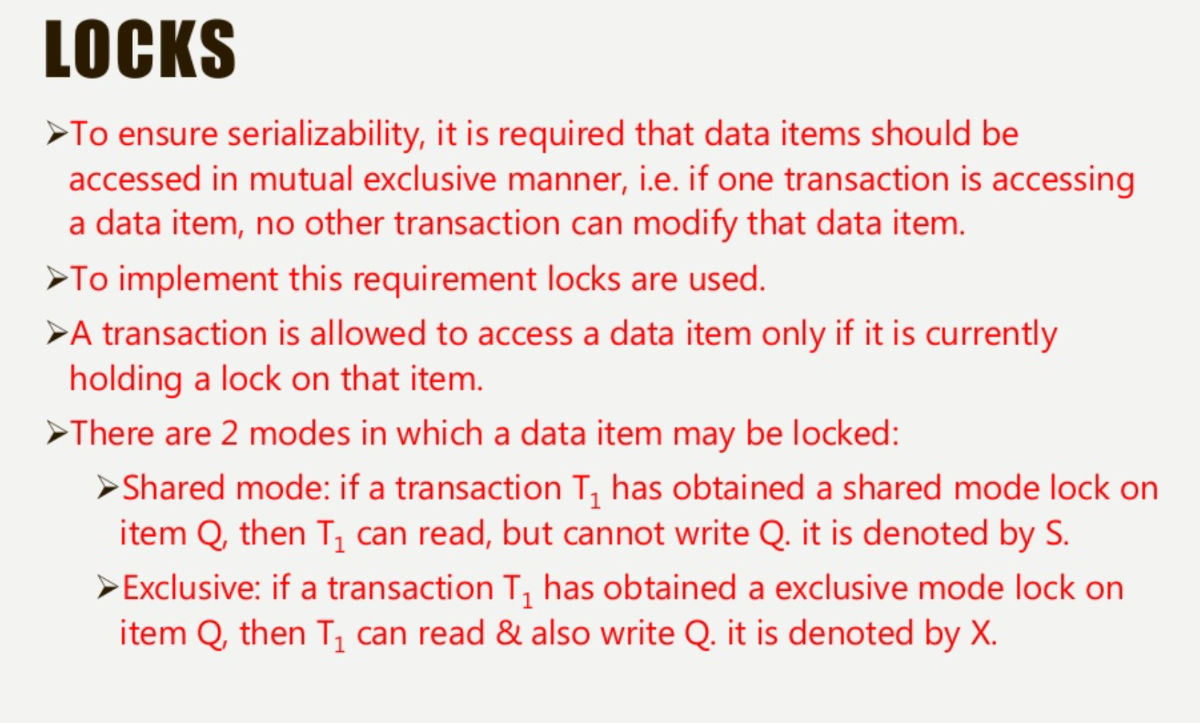

Slide 6




Data item can be locked in two modes

Slide 7

X-lock is requested using
lock-X instruction.
S-lock is requested using
lock-S instruction.

Slide 8










Lock –compatibility matrix
Compatible??

Slide 9

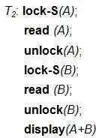
Ex: for performing locking

Slide 10
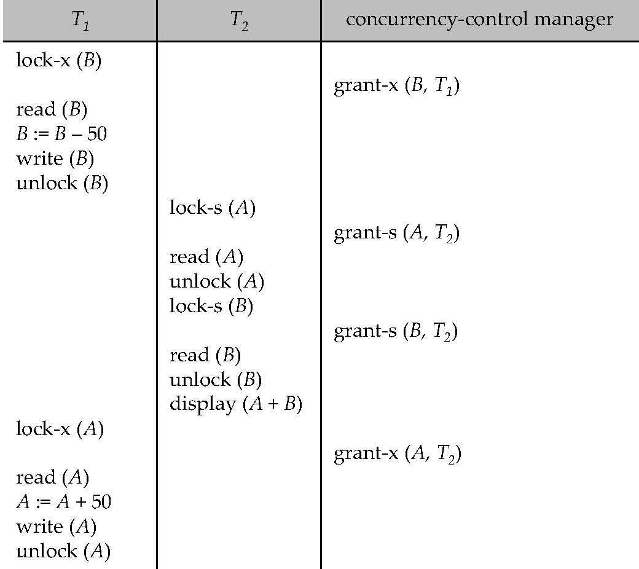


Slide 11


If a lock cannot be granted, the requesting transaction is made to wait till all incompatible locks held by other transactions have been released. The lock is then granted

Slide 12



Slide 13
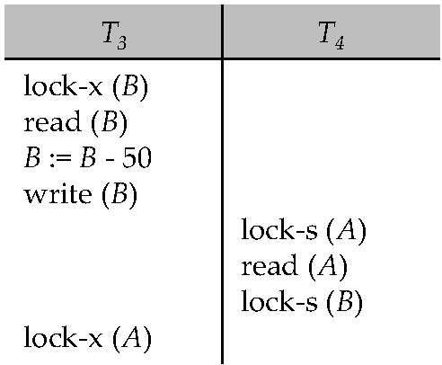
Consider the example for deadlock:

Slide 14


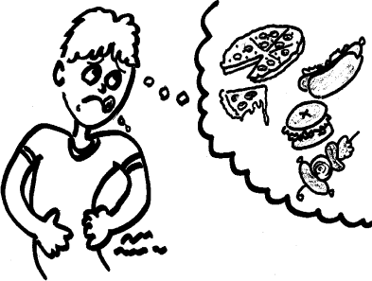

Starvation : If a transaction T never make a progress , then is said to be starved.

Slide 15


When a transaction T_{i} request a lock
on a data item Q in a particular mode M
We can avoid starvation by:
There is no other transaction holding a lock on Q in a mode that conflicts with M
There is no other transaction that is waiting for a lock on Q and that made its lock request before T_{i}

Slide 16



Set of rules each transaction in the system follow this rule
it is for ,when a transaction may lock or unlock each of its data items.
It restricts the number possible schedules

Slide 17

A schedule s is legal under a given locking protocol ,if s possible schedule for a set of transaction that follows the rules of the locking protocol

Slide 18
A locking protocol ensures conflict serializability if and only if all legal schedules are conflict serializable.

Slide 19

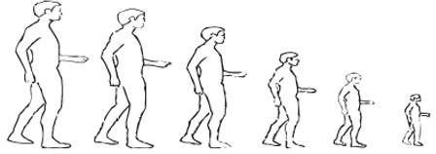
This is a protocol which ensures conflict
serializable schedules.
Phase 1: Growing Phase
transaction may obtain locks
transaction may not release locks
Phase 2: Shrinking Phase
transaction may release locks
transaction may not obtain locks

Slide 20
GROWING PHASE from in the given example
X(A)……………………R(B)
SHRINKING PHASE: from in the given example
U(A)………………U(B)
Once the transaction releases a lock ,it enters the shrinking phase and it can issue no more lock requests.
R(A) in T2 has to wait until lock is released by T1 and then it is executed.
T1 | T2
X(A)
R(A)
W(A)
 | R(A)
S(B)
R(B)
…..
……
…..
U(A)
…..
…..
….
…..
U(B)

Slide 21
Initially a growing
transaction is in the
phase. The transaction
acquires locks as needed.
Once the transaction releases a lock ,it enters the shrinking phase and it can issue no more lock requests.
Unlock instruction do not need to appear at the end of the transaction.

Slide 22


T₁:
lock-S(A);
read (A); unlock(A); lock-S(B);
read (B); unlock(B); display(A+B);
T₁:
lock-s(A);
read (A);
lock-S(B);
read (B);
unlock(A);
Unlock(B);
display(A+B^{LB})^{S};^{IT}

Slide 23



The point in the schedule where
the transaction
has obtained its final lock (the end of growing phase)
Two-phase locking does not ensure freedom from deadlocks

Slide 24

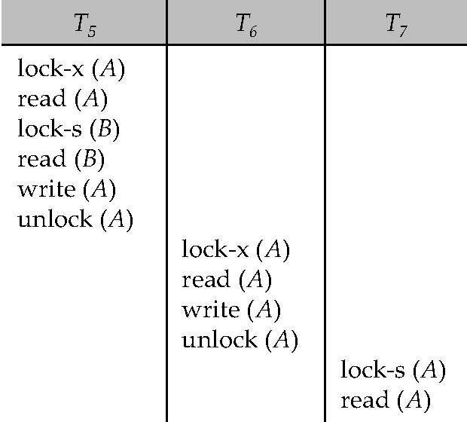
cascading rollback may occur under two phase locking

Slide 25
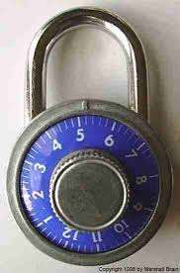

(a)Strict two phase locking (avoiding cascading rollback )
(b)rigorous two phase locking

Slide 26
all exclusive mode
locks of a transaction held until the transaction commit
all locks of a transaction held until
Ayt the transaction commit

Slide 27
T1 |  |  |  | X(B) | W(B) | U(B)
T2 | S(A) | R(A) | U(A) |  |  |  | X(B) | W(B) | U(B)
Example 1:
It is not in2PL bcoz after unlock no locks to be acquired.
But in the above example after A dataitem is unlocked in transaction T1 later it acquires lock on B data item
Example 2:
It is not in2PL bcoz X(B) is not realesed in T2 but again X(B) in T1 cannot acquire lock.
Example 3:
It is not in2PL bcoz in T2 unlock is dome after lock is not possible.i.e U(A)in T2 …..later T2 tries to acquire lock on X(B) which is not possible.
Example 4:
YES
T1 |  |  |  | X(B) | W(B) | U(B)
T2 | S(A) | X(B) | R(A) |  |  |  | W(B) | U(A) | U(B)
T1 |  |  | X(B) | W(B) |  | U(B)
T2 | S(A) | R(A) |  |  | U(A) |  | X(B) | W(B) | U(B)
T1 |  |  | X(B) | W(B) | U(B)
T2 | S(A) | R(A) |  |  |  | X(B) | U(A) | W(B) | U(B)

Slide 28

Two-phase locking with lock conversions:
First Phase:
can acquire a lock-S on item
can acquire a lock-X on item
can convert a lock-S to a lock-X (upgrade)
Second Phase:
can release a lock-S
can release a lock-X
can convert a lock-X to a lock-S (downgrade)

Slide 29



Slide 30
Another method for finding the serializability order
The protocol manages concurrent execution such that the time-stamps determine the serializability
A time stamp is assigned by the database system before the transaction starts execution.

Slide 31





Assume transactions comes in the order T1.T2,T3
If an old transaction T_{i} has time-stamp TS(T_{i}), a new transaction T_{j} is assigned time-stamp TS(T_{j}) such that TS(T_{i}) <TS(T_{j}).

Slide 32
BASIC TIME STAMP ORDERING PROTOCOL
100 | 200 | 300
T1 | T2 | T3
Older | Younger | Youngest
Unique value is assigned to each transaction
Tells the order (when they enter into the system)
Read-TS(RTS): Last (Latest) transaction number which performed READ operation successfully.
Write-TS(WTS) : Last (latest) transaction number which performed WRITE operation successfully.
ALWAYS WHICH TRANSACTION COMES FIRST WOULD COMPLETE FIRST
T1 100 | T2 200 | T3 300
R(A)
 | R(A)
 |  | R(A)
T1 100 | T2 200 | T3 300
W(A)
 |  | W(A)
 | W(A)

Slide 33
To Know what is RTS and WTS
T1 | T2 | T3 | T4
R(A)
W(A)
 |  | R(A)
 | R(A)
 |  |  | W(A)

Slide 34
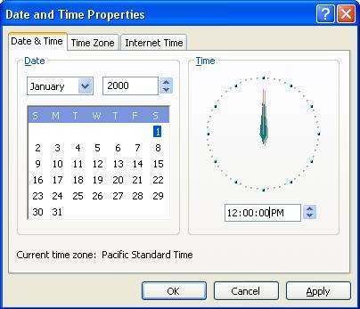


For implementing this we use two simple methods
Use the value of the system clock.
OR
Use a logical counter.

Slide 35



The time-stamps determine the serializability order , i.e. ensure that Ti appears before Tj.
maintains for each data Q two timestamp values:
.
is the largest time-stamp of any transaction that executed write(Q) successfully.
is the largest time-stamp of any transaction that executed read(Q) successfully

Slide 36
The timestamp ordering protocol ensures that any conflicting read and write operations are executed in timestamp order
The protocol operates as follows.

Slide 37


Suppose a transaction T_{i} issues a read(A) operation
If WTS(A) > TS(Ti),Rollback Ti.
Otherwise execute R(A) operation
Set RTS(A) = Max{RTS(A),TS(Ti)}

Slide 38


Suppose a transaction Ti issues a write(A) operation
If RTS(A)>TS(Ti) then Rollback Ti
If WTS(A)>TS(Ti) then Rollback Ti
Otherwise execute Write(A) Operation
Set WTS(A)=TS(Ti)

Slide 39
Conditions ------Conflict Pairs
Rollback T1
Rollback T2
Rollback T2
T1 | T2
 | W(A)
W(A)
. . . . Commit . | . . . . . . .****
T1 | T2
 | R(A)
W(A)
. . . . . .
T1 | T2
 | W(A)
R(A)
. . . . Commit . | . . . . . . .****

Slide 40
EXAMPLE
T1 100 Older | T2 200 Younger | T3 300 Youngest
R(A)
 | R(B)
W(C)
 |  | R(B)
R(C)
 | W(B)
 |  | W(A)
Suppose a transaction T_{i} issues a read(Q) operation
If WTS(A) > TS(Ti),Rollback Ti.
Otherwise execute R(A) operation
Set RTS(A) = Max{RTS(A),TS(Ti)}
Suppose a transaction Ti issues a write(Q) operation
If RTS(A)>TS(Ti) then Rollback Ti
If WTS(A)>TS(Ti) then Rollback Ti
Otherwise execute Write(A) Operation
Set WTS(A)=TS(Ti)
 | A | B | C
RTS | 0 | 0 | 0
WTS | 0 | 0 | 0
 | A | B | C
RTS | 100 | 300 | 100
WTS | 300 | 0 | 100

Slide 41


ensures freedom from deadlock
may not cascade-free
may not recoverable.

Slide 42

Problem with timestamp-ordering protocol:
Suppose T_{i} aborts, but T_{j} has read a data item written by T_{i ,} then T_{j} must abort; if T_{j} had been allowed to commit earlier, the schedule is not recoverable.
Further, any transaction that has read a data item written by T_{j} must abort this can lead to cascading rollback --- that is, a chain of rollbacks

Slide 43


Solution 1:
A transaction is structured such that its writes are all performed at the end of its processing
All writes of a transaction form an atomic action; no transaction may execute while a transaction is being written
A transaction that aborts is restarted with a new timestamp
Solution 2: Limited form of locking: wait for data to be committed before reading it
Solution 3: Use commit dependencies to ensure recoverability

Slide 44

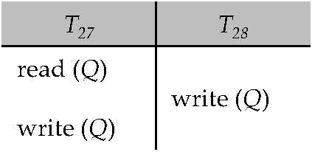
Consider the example Example :
Don’t worry, We have a soloution THOMAS WRITE RULE

Slide 45



Modified version of the timestamp-ordering protocol in which obsolete write operations may be ignored under certain circumstances.
When T_{i} attempts to write data item Q, if TS(T_{i}) < W- timestamp(Q), then T_{i} is attempting to write an obsolete value of {Q}.
– Rather than rolling back T_{i} as the timestamp ordering protocol would have done, this {write} operation can be ignored.

Slide 46

Otherwise this protocol is the same as the timestamp ordering protocol.
Thomas' Write Rule allows greater potential concurrency.
– Allows some view-serializable schedules that are not conflict-serializable

